Slide 1
Security in
Wireless Network Systems (I)
Week 15
General Overview

Slide 2
Outline
Introduction to Network Security
Confidentiality Using Conventional Encryption
Key Distribution
Public-Key Cryptography
Message Authentication
X.509 Certificates

Slide 3
Introduction to Network Security

Slide 4
Security Services
Confidentiality
Authentication
Integrity
Non-repudiation
Access Control
Availability

Slide 5
Security Attacks
Interruption: attack on availability (Fig. 1.1)
Interception: attack on confidentiality
Modification: attack on integrity
Fabrication: attack on authentication
Types of Security Attacks
  passive attacks
  active attacks

Slide 6
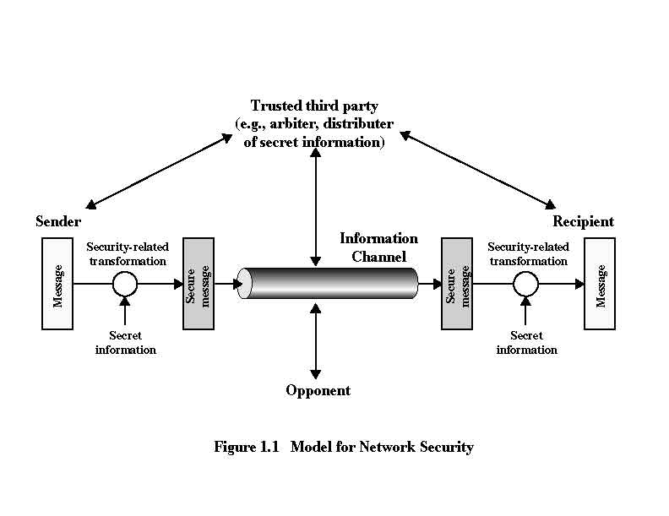

Slide 7
Passive Attacks
Goal: to obtain information that is being transmitted
Two types
  Release of message contents
  Traffic analysis

Slide 8
Active Attacks
masquerade
  one entity pretends to be a different entity
replay
  the passive capture of a data unit and its subsequent retransmission to produce an unauthorized effect
modification of messages
denial of service
  prevents the normal use or management of communication facilities

Slide 9
Confidentiality Using Conventional Encryption

Slide 10
Terminology
Cryptography
  the art or science encompassing the principles and methods of transforming an intelligible message into one that is unintelligible, and then retransforming that message back to its original form
Plaintext
  the original intelligible message
Ciphertext
  the transformed message

Slide 11
Terminology
Cipher
  an algorithm for transforming an intelligible message into one that is unintelligible by transposition and/or substitution method
Key
  some critical information used by the cipher, known only to the sender & receiver

Slide 12
Terminology
Encipher (Encode)
  the process of converting plaintext to ciphertext using a cipher and a key
Decipher (Decode)
  the process of converting ciphertext back into plaintext using a cipher and a key

Slide 13
Terminology
Cryptanalysis
  the study of principles and methods of transforming an unintelligible message back into an intelligible message without knowledge of the key. Also called codebreaking
Cryptology
  both cryptography and cryptanalysis
Code
  an algorithm for transforming an intelligible message into an unintelligible one using a code-book

Slide 14
Conventional Encryption
Conventional encryption
  symmetric encryption
  single-key encryption
Security depends on the secrecy of the key, not the secrecy of the algorithm
Formal model: Fig. 2.2
  Y = E_{K}(X)
  X = D_{K}(Y)

Slide 15
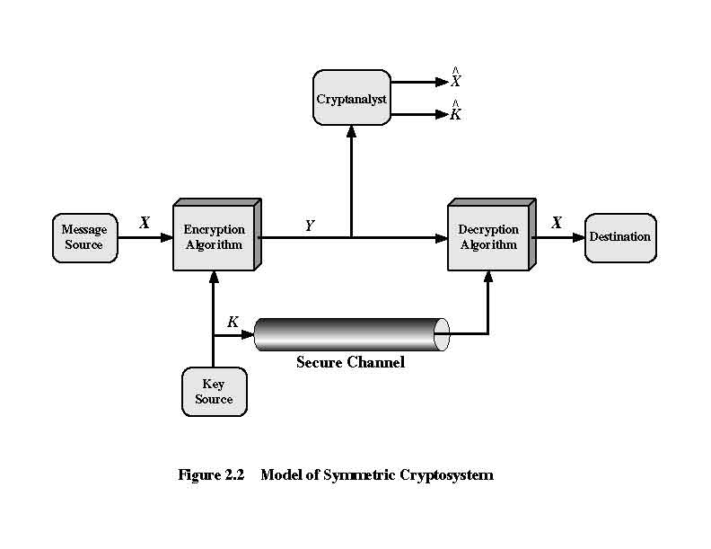

Slide 16
Cryptography
The type of operations used for transforming plaintext to cihpertext
  substitution
  transposition
The number of keys used
  single-key encryption
  two-key encryption
The way in which the plaintext is processed
  block cipher
  stream cipher

Slide 17
Cryptanalysis
Unconditionally Secure
  the ciphertext generated by the scheme does not contain enough information to uniquely determine the corresponding plaintext, no matter how much ciphertext is available or how much time is used
  one-time pad is the only unconditionally secure scheme
Computationally Secure
  the cost of breaking the cipher exceeds the value of the encrypted information
  the time required to break the cipher exceeds the useful lifetime of the information

Slide 18
Classical Encryption Technique
Substitution
  Caesar Cipher
    plain: meet me after the toga party
    cipher: PHHW PH DIWHU WKH WRJD SDUWB
    C = E(p) = (p+3) mod 26
    p = D(C) = (C-3) mod 26
    Brute-force cryptanalysis: 25 possible keys

Slide 19
Classical Encryption Technique
Transposition: permutation
  Rectangle
    Plain: attack postponed until two am
    Key 4 3 1 2 5 6 7
    Plain: a t t a c k p
    o s t p o n e
    d u n t i l t
    w o a m x y z
    Ciphertext : ttnaaptmtsuoaodwcoixknlypetz

Slide 20
DES
Data Encryption Standard
encrypted in 64-bit blocks using 56-bit key
Adopted by NIST
Two critics
  key size: LUCIFER 128 bits -> DES 56 bits
  S-boxes: design criteria are classified
DES is widely used
NIST reaffirmed DES for federal use until 1999 for applications other than classified information

Slide 21
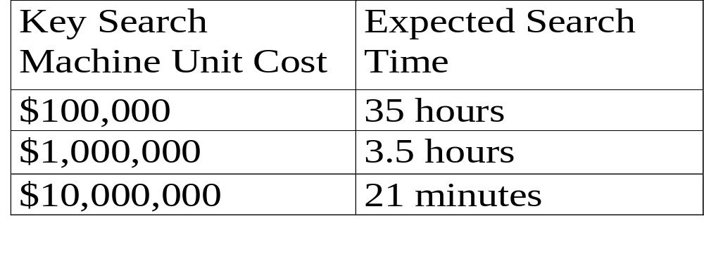
Concern about DES
56-Bit Keys
  Cryptanalysis by Wiener in 1993 based on known plaintext attack
  Wiener 1997: search time / 6
  DES to be replaced by triple DES and IDEA

Slide 22
DES Modes of Operations
Electronic Codebook (ECB) Mode
  the plaintext is handled 64 bits at a time and each block of plaintext is encrypted using the same key
  ideal for a short amount of data such as an encryption key
  may not be secure for lengthy messages: the same 64-bit block of plaintext always produces the same ciphertext
  Fig. 3.11

Slide 23
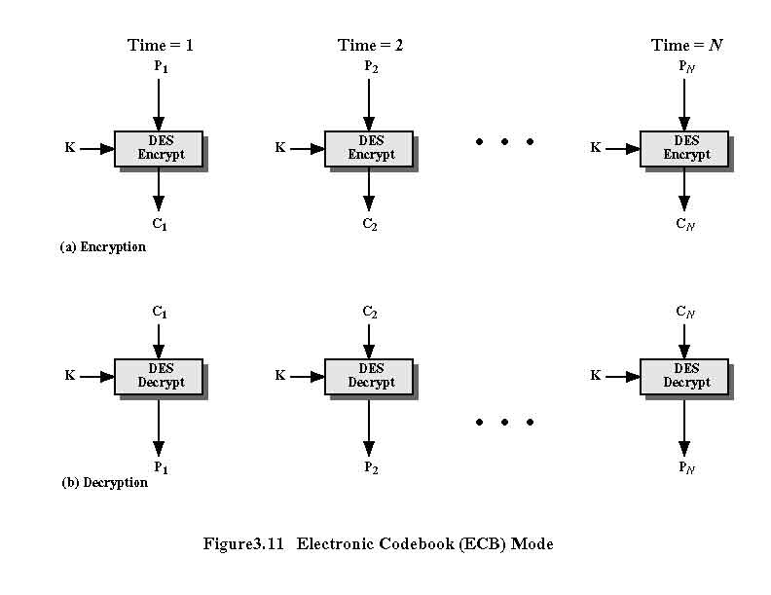

Slide 24
DES Modes of Operations
Cipher Block Chaining (CBC) Mode
  the same plaintext produces different ciphertext blocks
  the input to the cipher is the XOR of the current plaintext block and the preceding ciphertext block; the same key is used for each block
  Fig. 3.12
    IV means Initialization Vector
    IV must be protected as well as the key
    sending IV using ECB encryption
  An appropriate mode for encrypting messages of length greater than 64 bits

Slide 25
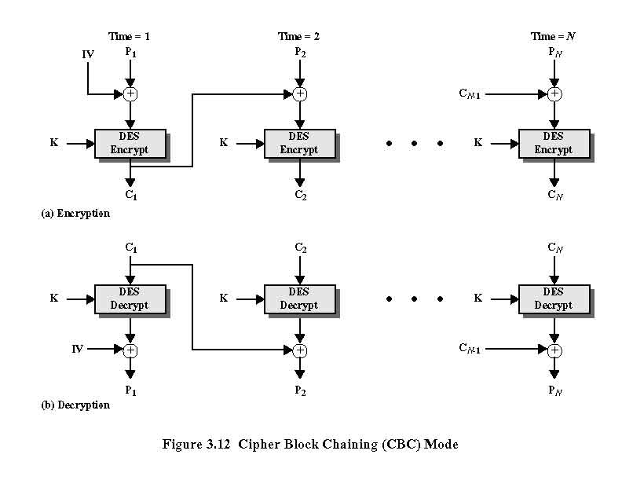

Slide 26
DES Modes of Operations
Cipher Feedback (CFB) Mode
  to convert DES into a stream cipher
  Fig. 3.13
A stream cipher eliminates the need to pad a message to be an integral number of blocks

Slide 27
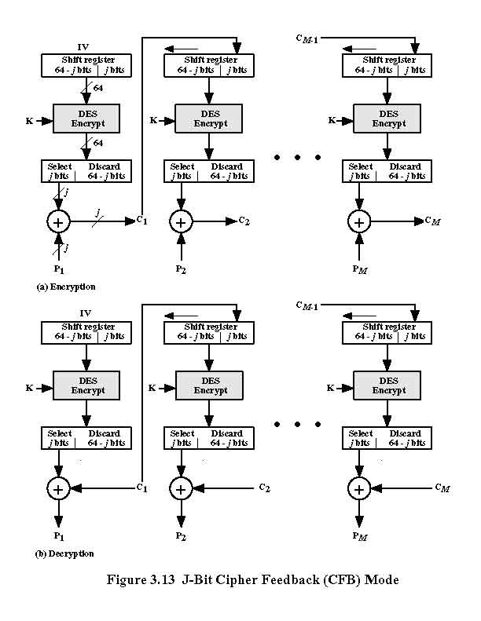

Slide 28
DES Modes of Operations
Output Feedback (OFB) Mode
  the output of the encryption function is fed back to the shift register in OFB
  Fig. 3.14
  advantage: the bit errors in transmission do not propagate. A bit error in C1 does not corrupt subsequent texts
  disadvantage: more vulnerable to a message-stream modification attack than is CFB. Complementing a bit in the ciphertext complements the corresponding bit in the recovered plaintext. Thus, controlled changes to the recovered plaintext can be made.

Slide 29
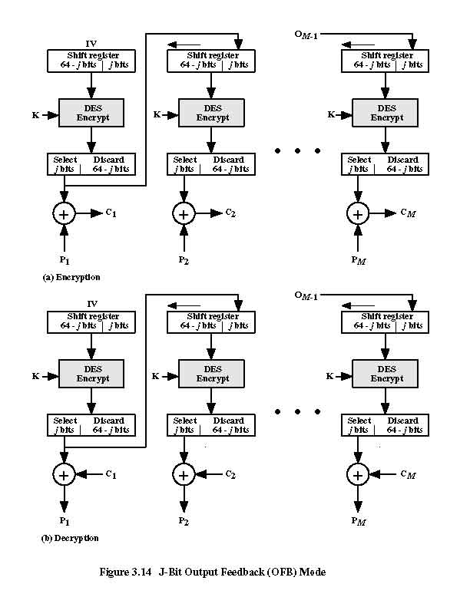

Slide 30
AES
Advanced Encryption Standard
Used in WPA2 (Wireless Protected Access)

Slide 31
Key Distribution

Slide 32
Key Distribution
Frequent key changes are desirable to limit the amount of data compromised if an attacker learns the key
Key distribution technique
  the means of delivering a key to two parties without allowing others to see the key

Slide 33
Key Distribution
Key distribution from A to B
  1. A key is selected by A and physically delivered to B
  2. A third party selects the key and physically deliver it to A and B
  3. If A and B have previously and recently used a key, one party can transmit the new key to the other, encrypted by using the old key
  4. If A and B each has an encrypted connection to a third party C, C can deliver a key on the encrypted links to A and B
1 and 2 are awkward for end-to-end encryption

Slide 34
Key Distribution Center
KDC: distributing keys to pairs of users.
Hierarchy of keys
  master keys
  session keys

Slide 35
Key Distribution Center
Advantages
  Reducing the problem of key distribution
  Number of (master) keys that must be maintained for the system is small (N compared to N(N-1)/2 for session keys)

Slide 36
Key Distribution Scenario
Function: to exchange session keys
Scenario: Fig. 5.9
Request: includes ID_{A} and ID_{B}
Nonce
  a timestamp, a counter, or a random number that differs with each request
  to prevent replay

Slide 37
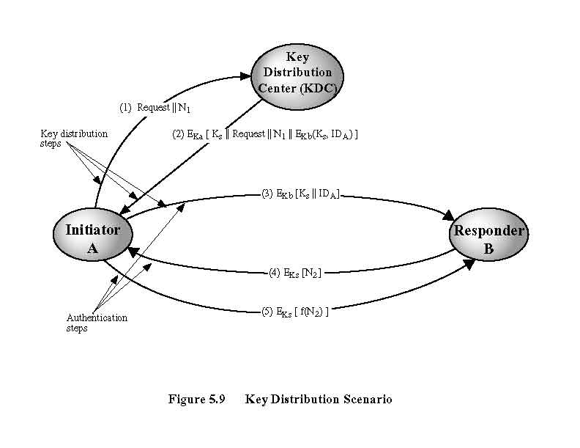

Slide 38
Key Distribution Scenario
Steps 1 - 3: key distribution
Steps 4 - 5: to assure B that the message was not a replay (authentication)
KDC must be trusted

Slide 39
Session Key Life
Frequent session key exchange: more secure
Disadvantage of distributing session key: delays the start of any information exchange
Connection-oriented protocol: for the session
Connectionless protocol
  for a certain fixed period
  for a certain number of transactions

Slide 40
Public-Key Cryptography

Slide 41
Public-Key Cryptology
1976 Diffie and Hellman: first public presentation of public-key concept
1978: RSA algorithm by Rivest, Shamir, and Adelman
The greatest revolution in the history of cryptography
Based on Mathematics, rather than Substitution and Permutation
using two keys, rather than only one key

Slide 42
Public-Key Cryptosystems
A key for encryption, a different key for decryption
Characteristics
  It is computationally infeasible to determine the decryption key given only the cryptographic algorithm and the encryption key
  (for RSA) either of the two related keys can be used for encryption, and the other used for decryption

Slide 43
Public-Key Encryption
Terms
  Secret key: used in conventional encryption
  Public key
  Private key

Slide 44
Public-Key Cryptosystem:
Secrecy and Authentication
Fig. 6.4
Z = E_{KUb} [ E_{KRa} (X) ]
X = D_{KUa} [ D_{KRb} (Z) ]

Slide 45
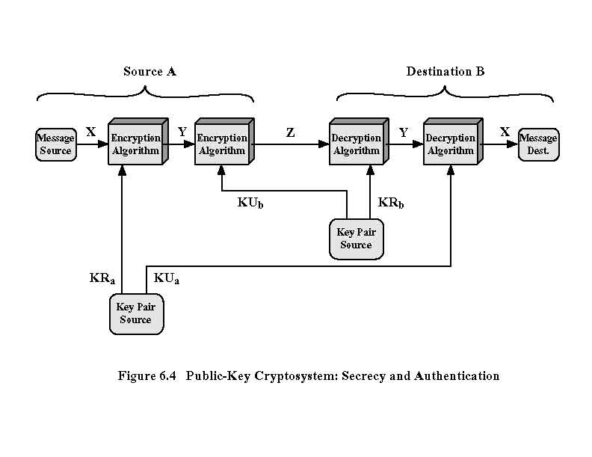

Slide 46
Applications
Applications for Public-Key Cryptosystems
  Encryption / Decryption
  Digital Signature
  Key Exchange : to exchange session keys

Slide 47
Message Authentication

Slide 48
Authentication Function
Authenticator: a value to be used to authenticate a message
Types of functions that produce an authenticator
  Message encryption
  Message authentication code (MAC)
  Hash function

Slide 49
Conventional Encryption
Message encryption itself provides a measure of authentication
Fig. 8.1: Confidentiality and Authentication
Problem: there must be some automated means of determining at B whether Y is legitimate plaintext and therefore must have come from A,
given Y = D_{K} ( X )
Only a small subset of all possible bit patterns is to be considered legitimate plaintext

Slide 50
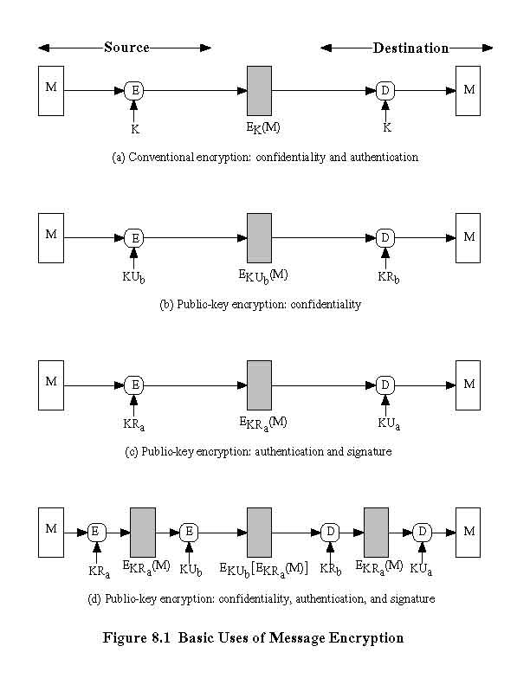

Slide 51
Checksum
Error-detecting code
Frame check sequence (FCS)
Solution to the previous problem: appending a structure like checksum
Fig. 8.2
  Internal error control: authentication of messages
  External error control: can be forged
TCP Header: one can simply encrypt the datagram except the IP header

Slide 52
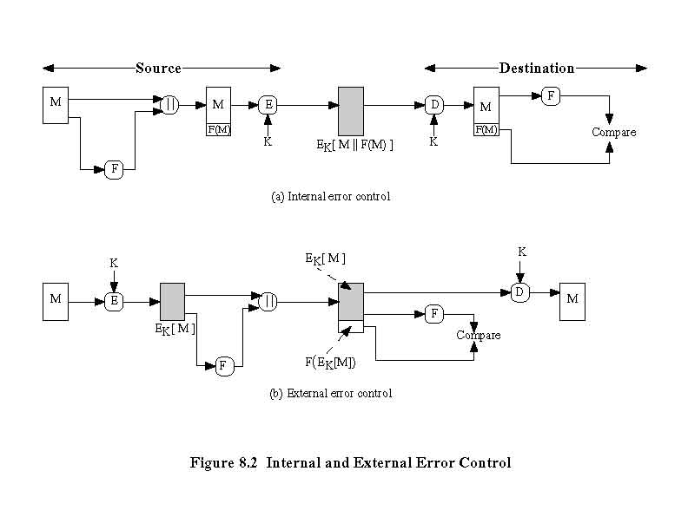

Slide 53
Public-Key Encryption
Fig 8.1
Confidentiality
Authentication and Signature
  again: some internal structure to distinguish between plaintext and random bits
Confidentiality, Authentication and Signature

Slide 54
Message Authentication Code
MAC (Message Authentication Code): using a secret key to generate a small fixed-size block of data
Fig. 8.4a: authentication
  The receiver is assured that the message has not be altered.
  The receiver is assured that the message is from the alleged sender
  The receiver is assured of the sequence because an attacker can not alter the sequence number

Slide 55
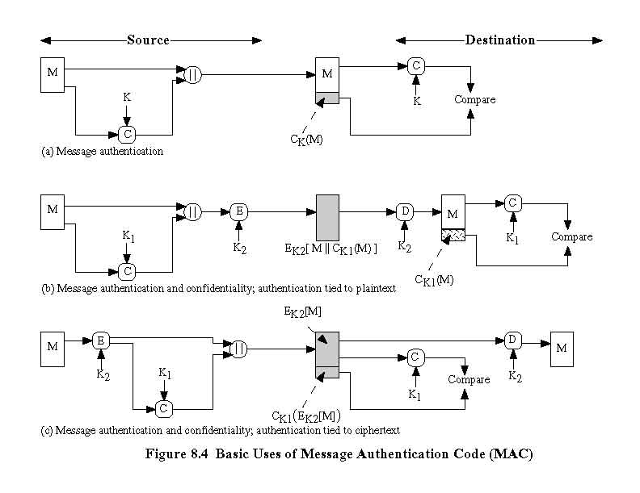

Slide 56
Message Authentication Code
Checksum algorithm need not be reversible
Mathematical Properties: Checksum is less vulnerable to being broken than is encryption
Authentication and Confidentiality: Fig. 8.4b, c
  Fig. 8.4b is preferred

Slide 57
Hash Function
One-way hash function, or Message digest
H(M): accepts a variable-size message, and produces a fix-size hash code
a change to any bit or bits in the message results in a change to the hash code

Slide 58
Basic Use of Hash Function
Fig. 8.5a: hash code provides authentication
Fig. 8.5b: as a cryptographic checksum
Fig. 8.5c: authentication and digital signature
Fig. 8.5d: digital signature and confidentiality
Fig. 8.5e: authentication. S is a shared value
Fig. 8.5f:authentication and confidentiality
For authentication only: b and c are better, less computation time without encryption

Slide 59
Source
Destination
||
E
D
M
H
M
K
K
Compare
(a)
H
E_{K}[MH(M)]
H(M)
M
H
M
||
K
K
Compare
(b)
H
E
D
E_{K}[H(M)]

Slide 60
M
H
M
||
KR_{a}
KU_{a}
Compare
H
E
D
E_{KRa}[H(M)]
(c)

Slide 61
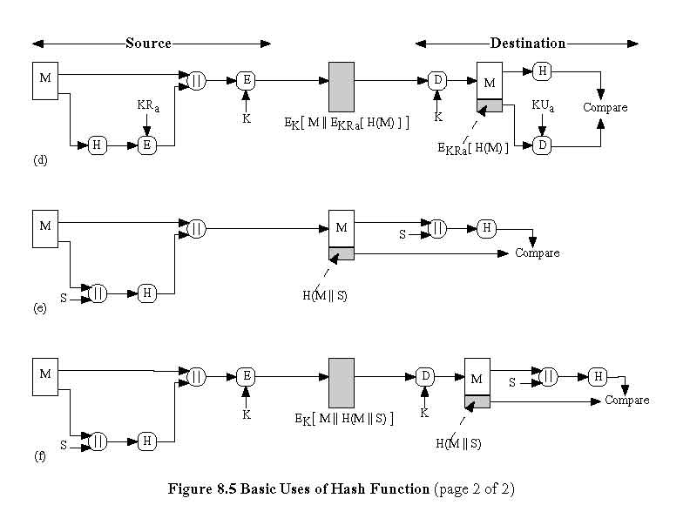

Slide 62
X.509
CCITT recommendation X.509 is part of the X.500 series of recommendations that define a directory service
Directory is a database of information
  includes a mapping from user name to network address, and other information about the users
X.509
  defines a framework for the provision of authentication services by the X.500 directory to its users

Slide 63
Certificates
Public-key certificates associated with each user
Certificates are created by certification authority (CA)

Slide 64
Certificates
General format of a certificate
  Fig. 11.3
  Version: the latest version = 3
  Serial number: an integer value, unique within the CA
  Issuer name: X.500 name of the CA
  Signature: covers all of the other fields of the certificate, and consists of a hash code of the other fields, encrypted with the CA’s private key

Slide 65
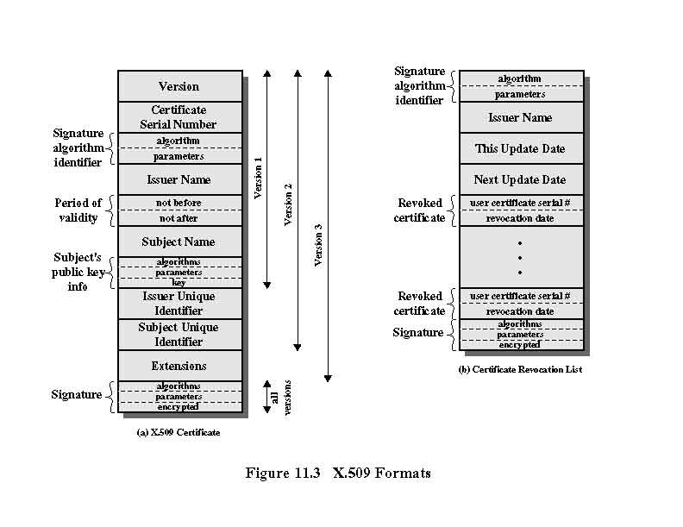

Slide 66
Characteristics of Certificates
Any user with access to the public key of the CA can recover the user public key that was certified
No party other than the CA can modify the certificate without this being detected (unforgeable)
  certificates can be placed in a directory without protection

Slide 67
CA’s Public Key
CA’s public key must be provided to each user in an absolutely secure (with respect to integrity and authenticity) way so that the user has confidence in the associated certificates.

Slide 68
Revocation of Certificates
Reasons
  the user’s private key is assumed to be compromised
  the user is no longer certified by this CA
  the CA’s private key is assumed to be compromised
Certificate Revocation List (CRL) (Fig. 11.3)
  Each CA must maintain a list of all revoked but not expired certificates issued by the CA
Users maintains a local cache of certificates and CRL

Slide 69
Reference
Cryptography and Network Security: Principles and Practices. By William Stallings. 3rd Edition. Prentice Hall.

